Slide 1

Regional Coordination Task Force Update
October 28, 2024

Slide 2
Topics
Day-Ahead Market Participation
Order 2023

Slide 3
Status of the Day-Ahead Market Options
NV Energy has been an active participant in the development of the two day ahead market options in the West: CAISO’s Extended Day-Ahead Market (EDAM) and SPP’s Markets+ and has worked with other utilities on several studies evaluating potential benefits associated with the different markets and possible footprints
  CAISO’s EDAM Tariff has been approved by FERC
    initiated the EDAM stakeholder process in November 2021
    Filed tariff changes at FERC on August 22, 2023. The Order issued December 20, 2023, largely accepted the new market design. With respect to the EDAM transmission rate, CAISO made a subsequent filing in Docket No. ER24-1746 on April 12, 2024, and the changes were accepted by FERC on June 11, 2024
  SPP’s Markets+ Tariff is pending with FERC
    Initiated discussions with stakeholders in late 2021 and published service offering in November 2022
    Stakeholder process on tariff development in 2023 resulted in filing of the Markets+ tariff at FERC on April 5, 2024, in Docket No. ER24-1658
    FERC deficiency letter issued July 31, 2024
    Response filed September 20, 2024; requested order by November 20, 2024

Slide 4
Incremental Organized Market Expansion
The PUCN authorized NV Energy’s participation in the CAISO’s Energy Imbalance Market or “EIM” in Docket 14-04024 in August 2014. NV Energy joined in December 2015. By any measure, the EIM has been a tremendous success enabling NV Energy to capture economic, reliability and environmental benefits for customers
The decision to proceed with day ahead market participation is consistent with the desire of many of the other Western Balancing Authorities to pursue market expansion on an incremental basis
At this point, neither EDAM nor Markets+ provides a direct path towards the requirement in SB 448 for the Company to participate in an RTO by January of 2030. While continuing to explore all market options, NV Energy seeks to capture additional benefits for its customers
In the most recent IRP (the May 31, 2024, filing in Docket 24-0541), NV Energy stated “the Companies intend to request authorization from the Commission to participate in the CAISO Extended Day-Ahead market”

Slide 5
PUCN Decisional Criteria
Docket No. 23-10019
PUCN Workshops:
  March 4 – examined the appropriate the process for the Commission’s evaluation of NV Energy’s recommendation
  April 3 – reviewed the day ahead market benefit studies
  April 10 – discussed the day ahead market designs
June 21, 2024, Order
  Any request by NV Energy to join a day ahead market shall be made through separate amendments to the Energy Supply Plan, outside of their now-pending application for their Integrated Resource Plan and Energy Supply Plan in Docket No.24-05041
  Extensive list of issues to address

Slide 6
Criteria From Docket No. 23-10019
Governance of the DAM and the overall organization of the entity that owns the DAM, including the process by which changes to the FERC approved DAM tariff occur, to include any opportunities for the Commission to participate in the DAM change process prior to a filing at FERC | Status of the DAM and applicable timeline for the DAM and NV Energy joining – (1) copies of all DAM implementation agreements and (2) any related or required amendments to NV Energy's internal business practices and procedures
Overall financial health of organization that owns the DAM, as well as the financial statements of that organization | Interoperability with the WRAP, NV Energy's ESP, and state resource adequacy requirements
An explanation of the market monitoring function at the DAM, the dispute resolution process at the DAM, and the functioning of the DAM States Committee | Revisions to the OATT that NV Energy will make once it joins the DAM. Complete tariff language may not be necessary, but an adequate level of detail to allow review of the potential impact on NV Energy's BAA;
Current non-Nevada utility commitments and the nature of those commitments to the DAM | Impact on NV Energy's Renewable Portfolio Standard compliance
Diversity of resources available through the DAM | Roadmap to RTO in compliance with NRS 704.79882 if the DAM is joined
Resiliency of the DAM system to physical threats, such as wildfire, and vulnerability to cyber-security threats | Process by which the DAM and NV Energy ensure retail customers are compensated for available transmission capacity, including congestion revenues
Transparency of the DAM's market data – (1) type and location of the data currently available; (2) type and location of the data that will be available after NV Energy joins; (3) how the Commission can access that data; and (4) frequency with which the data is/will be available to the Commission | Concerns regarding impacts of the DAM on non-jurisdictional transmission customers in NV Energy's BAA, including: (1) pricing and settlement transparency; (2) participation and representation in the DAM; and (3) responsibilities of those customers with respect to the resource adequacy and compliance obligations
GHG emission tracking of resources purchased in the DAM, as well as any “leakage” that might occur; | Any capital investment in transmission or generation that may be necessary to participate in the DAM or maximize the benefit of the DAM
All cost-benefit analyses that demonstrate the value of the DAM versus other options, including any viable, alternate DAMs and the "status quo" that examines, at a minimum, the following information: (1) impact of transfers between markets and balancing areas; (2) analysis of resource procurements; (3) any costs related to solar energy curtailment; (4) use of the most recently available applicable to Nevada-specific inputs; (5) impact on transmission development and investments currently proposed or in progress for Nevada by NV Energy or other developers; and (6) impact on generation development currently approved or proposed by NV Energy | Costs of utility participation in the DAM, including fees, metering and software requirements. All new costs should be highlighted and estimated based on the most applicable, recent data, even if they are not yet known with precision or are expected to be offset. Any expected offsets should be thoroughly analyzed;
Forecast of rate and revenue impacts for the 5 and 10 years immediately after joining the DAM; | Process, timeline, and costs to exit the DAM

Slide 7
Key Factors
Experience with the EIM
Footprint and connectivity
Projected customer benefits
Market design
Governance
Intangibles

Slide 8
Experience
NV Energy and its customers have already invested in the EIM
  EDAM will require upgrades but we are already interfacing with CAISO’s systems and system model
EIM has demonstrated substantial benefits
NV Energy merchant and transmission operations staff have operating experience in the CAISO real-time environment

Slide 9
NV Energy Benefits
(From the CAISO Quarterly Reports)
 | 2016 | 2017 | 2018 | 2019 | 2020 | 2021 | 2022 | 2023 | 2024
January | 0.34 | 1.07 | 0.87 | 1.09 | 1.10 | 1.36 | 1.36 | 17.93 | 8.69
February | 0.75 | 1.31 | 2.07 | 2.20 | 1.80 | 10.99 | 1.61 | 8.34 | 8.53
March | 0.62 | 1.12 | 1.23 | 2.42 | 2.46 | 1.79 | 1.44 | 20.92 | 15.55
Q1 Total | 1.70 | 3.50 | 4.17 | 5.71 | 5.36 | 14.14 | 4.41 | 47.19 | 32.77
April | 1.09 | 2.37 | 2.55 | 1.23 | 2.34 | 1.52 | 2.49 | 20.32 | 9.82
May | 1.34 | 2.25 | 1.98 | 1.33 | 1.51 | 1.88 | 2.40 | 8.89 | 12.24
June | 2.77 | 1.08 | 0.81 | 2.06 | 0.88 | 2.80 | 3.74 | 16.95 | 11.59
Q2 Total | 5.20 | 5.70 | 5.34 | 4.62 | 4.73 | 6.20 | 8.63 | 46.16 | 33.65
July | 1.88 | 2.28 | 4.07 | 1.47 | 1.89 | 7.44 | 10.67 | 25.32
August | 2.16 | 3.41 | 4.96 | 1.52 | 4.18 | 3.08 | 20.42 | 19.96
September | 1.55 | 2.86 | 2.06 | 2.93 | 2.74 | 7.52 | 31.29 | 15.02
Q3 Total | 5.60 | 8.55 | 11.09 | 5.92 | 8.81 | 18.04 | 62.38 | 60.30
October | 1.00 | 2.63 | 1.73 | 2.47 | 3.73 | 2.87 | 7.38 | 9.40
November | 1.47 | 2.96 | 1.51 | 2.63 | 1.60 | 3.37 | 9.69 | 6.29
December | 0.60 | 0.86 | 1.71 | 1.52 | 0.39 | 3.14 | 25.26 | 6.77
Q4 Total | 3.07 | 6.45 | 4.95 | 6.62 | 5.72 | 9.38 | 42.33 | 22.46
Annual Total | 15.57 | 24.20 | 25.55 | 22.87 | 24.62 | 47.76 | 117.75 | 115.81 | 66.42
December 2015 = $0.84 million
Total NV Energy EIM Benefits through June 2024 = $521.69 million

Slide 10
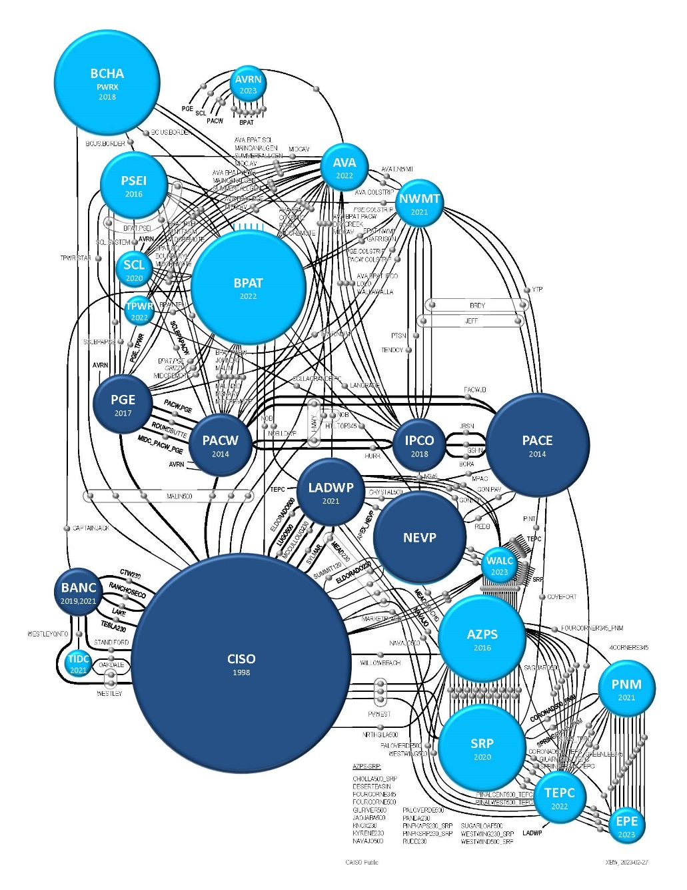
Footprint and Connectivity
Several balancing areas committing to or indicating interest in* participating in EDAM
Covers nearly 50% of the demand in the West
  PacifiCorp
  Balancing Area of Northern California
  Los Angeles Dept. of Water and Power
  Portland General Electric
  Idaho Power Corp*
  NV Energy*
CAISO Public

Slide 11
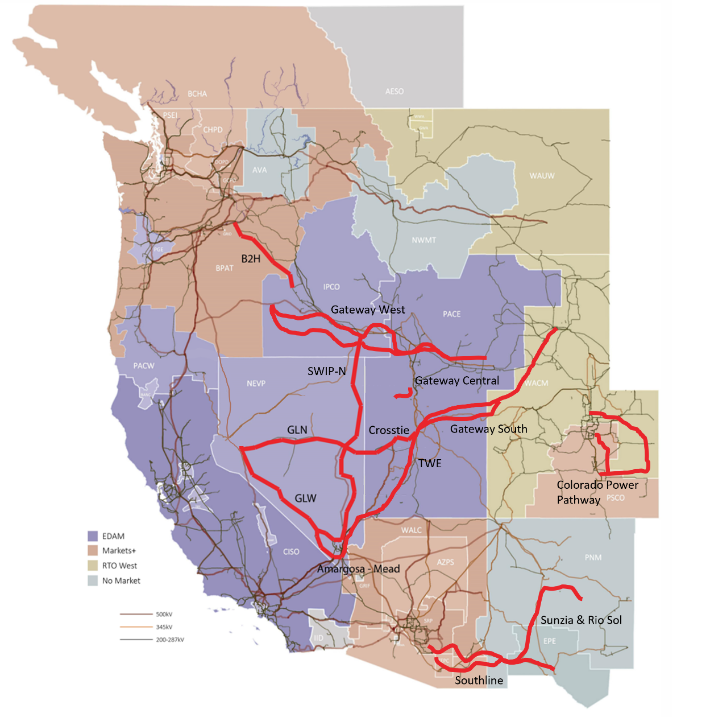
Footprints, Connectivity and Transmission Projects
Path 76 – the Alturas 165 mile, 345 kV line from BPA’s Hilltop to NVE’s Ft. Sage with a rated transfer capacity of 300 MW (bidirectional)

Slide 12
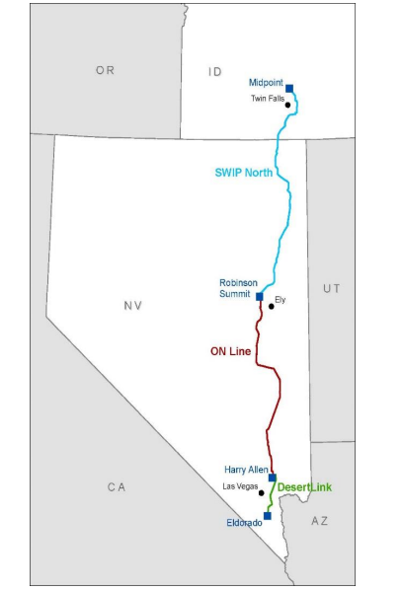
LS Power SWIP-North Project
Currently, NV Energy has use of all the ON Line capacity - 900 MW (north-to-south and 600 MW (south-to-north)
SWIP-North increases the total ON Line capacity north-to-south to 2,335 MW and the south-to-north to 2,245 MW with the additions being shared by NV Energy, CAISO and potentially Idaho Power
With SWIP-North, NV Energy’s ON Line capacity
  + 317 MW increase north-to-south
  + 572 MW increase south-to-north
NV Energy also receives a SWIP-North allocation
  + 952.5 MW north-to-south
  + 847.5 MW south-to-north
With NV Energy and Idaho Power in EDAM the total of both SWIP North and ON Line supports the market

Slide 13
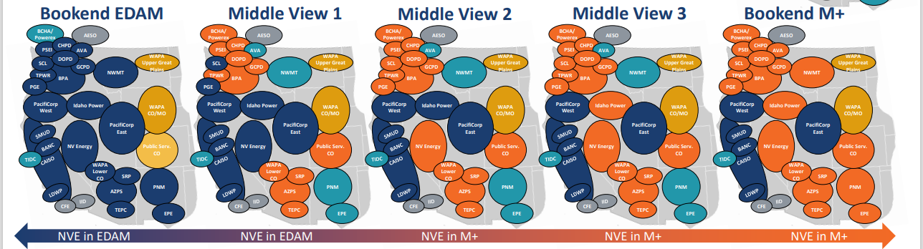
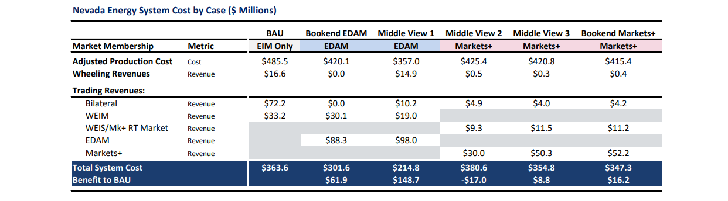
Projected Customer Benefits
Brattle Results

Slide 14
Market Design
  Congestion rent allocations: The EDAM methodology allows NV Energy, as the transmission provider, to treat all customers equally based on usage of the system. In Markets+ congestion is to paid based on reservations not actual schedules, this can create winners and losers
  Virtual bidding: NV Energy has concerns that there may be defined pricing patterns that will allow financial speculators to profit from virtual bidding with no discernible market benefit. EDAM has slower and more considered implementation path; In Markets+ virtual bidding goes live after 6 months
  GHG: EDAM is based on enhanced version of EIM methodology that has been acceptable to NV Energy. The Company has a greater concern than Markets+ methodology can lead to GHG zones impacting prices in non-GHG regions
  Resource sufficiency: NV Energy has greater confidence in the ability of EDAM with the resource sufficiency test and the FERC-approved imbalance reserve product to handle intra-day uncertainty

Slide 15
Governance
SPP’s Markets+
  SPP has an independent, 10-member Board of Directors
  Oversight of Markets+ is delegated to an independent, 5-person Markets+ Independent Panel (one of the five is to be a Board member)
The West-Wide Governance Pathway Initiative has resulted in significant changes to EIM and EDAM oversight
  As approved, Step 1 transitions the division of authority between the 5-person Governor-appointed CAISO Board of Directors and the 5-person, independent Western Energy Market Governing Body (the WEM GB) from a joint-authority model to the WEM having primary authority over the markets
  Step 2 would include a modification of California law to permit an expanded form of the WEM GB to have sole authority over the EIM and EDAM markets
Board oversight is only part of the governance structure. A key component is the stakeholder process to consider new market initiatives and reforms
FERC is the ultimate abitur of the justness and reasonableness of the market design reflected in the tariff

Slide 16
Stakeholder Process
Markets+ uses a stakeholder led process; staff has a more passive role
In the CAISO process, stakeholders represent their interests, and staff has a more active role in balancing positions
NV Energy sees a number of advantages to the CAISO approach:
  Staff involvement helps protect minority interests that can get overruled by SPP’s deterministic voting structure
  Greater use of written comments in the CAISO process allows fuller definition of positions and earlier review by the WEM GB who cannot attend all the stakeholder meetings
  CAISO’s initiative-specific process is less bureaucratic than SPP’s formal committee structure; can react more quickly to emerging events
  West-Wide Governance Pathways promoting further improvements to the CAISO process including greater use of indicative voting and additional involvement in determining which issues to stakeholder

Slide 17
Intangibles
  NV Energy has a high confidence that CAISO, PacifiCorp, Portland General and the other first movers will stand-up the EDAM market and that EDAM will have the connectivity to produce benefits for customers. NV Energy has less confidence in Markets+, even if entities spend the $150 million necessary for SPP to build out the design. NV Energy perceives a risk that participation in Markets+ could lead to substantial expenditures with limited results
  There is no exit fee in EDAM. Whereas were NV Energy to participate in Markets+, the Company could be responsible for incurred capital costs
  With EDAM there is greater assurance of recovery of implementation costs and the lack of an exit fee is consistent with NV Energy’s least-regrets approach

Slide 18
Current Thoughts on Schedule
Currently targeting a filing with the PUCN in the second quarter of 2025
  Complete the currently-pending IRP
  Potential further definition of market footprints
  Additional work identifying NV Energy system upgrades
  PacifiCorp’s EDAM OATT FERC filing expected in November 2024; Portland General in January 2025
Earliest potential go-live date of Spring 2027

Slide 19
EDAM is the Next Step
Not the Endpoint
RTO Functions (adopted from NIPPC’s June 24, 2024 Task Force Presentation)
Market services:
  Real-time energy (see Western Energy Imbalance Market (WEIM))
  Day-ahead energy (see Extended Day-Ahead Market (EDAM))
  Ancillary services co-optimization
  Congestion revenue rights
Reliability Coordination
Transmission control:
  Transmission operations, including congestion management
  A consolidated transmission service tariff, including procedures for requesting transmission and interconnection service
  Flow-based, financial transmission reservations
  De-pancaking of some transmission rates
  Regional and interregional transmission planning
Balancing authority services
Resource adequacy provisions

Slide 20
Order No. 2023 – Certain Elements
Order 2023 was issued by FERC in Docket RM22-14 on July 28, 2023, and became effective on November 3, 2023,
Some highlights from the order include:
  Provides for an annual cluster study process
  Specifies allocations of study costs and responsibilities for network upgrades
  Imposes a penalty if a customer’s withdrawal of from the queue has an impact on the cost or timing of any interconnection requests with an equal or lower queue position
  Eliminates the reasonable efforts standard and introduces penalties if a transmission provider fails to meet study deadlines
NV Energy’s compliance filing was submitted on April 26, 2024, and requested an effective date of July 1, 2024; no decision by FERC as yet; however, FERC’s decision can be made effective as of July 1
  NV Energy is moving forward as if the compliance filing is in effect. This approach is consistent with Order No. 2023-A and ratified in a recent El Paso Electric case
  New rules apply to any project without an agreement executed by July 1, 2024
  NV Energy will accept requests during a 45-calendar day Cluster Request Window that will be held annually starting June 15, 2025 (June 15th- July 30th)

Slide 21
Key Change – Site Control
Site control is defined as the exclusive land right to develop, construct, operate and maintain the generating facility
It can be demonstrated by documentation establishing: (1) ownership or a right to develop a site; (2) an option to purchase or acquire a leasehold site; or (3) any other demonstration that clearly demonstrates the right of interconnection customer to exclusively occupy a site
The interconnection customer must provide evidence of 90% site control at the time of submission of the interconnection request, and 100% site control at the time of execution of the facilities study agreement
Prior to Order No. 2023, the interconnection customer could submit a deposit in lieu of site control. Under Order No. 2023,
  the interconnection customer can use a deposit instead of site control demonstrations where regulatory limitations may prohibit customers from obtaining site control
  However, the customer needs to demonstrate physical control within 180 days of execution of interconnection agreement

Slide 22
Site Control Issue in
FERC Docket ER24-1847
NV Energy’s proposals on site control
  Bureau of Indian Affairs - Easement and resolution from the applicable tribe
  State of Nevada- Easement from the state
  United States Forest Service USFS - a Special Use Permit
  Bureau of Land Management
    For sites subject to the competitive leasing process – a BLM lease agreement
    For the BLM non-competitive process - a ROW Grant
Late-filed challenges in the NV Energy FERC Compliance raised the issue of what constitutes “site control” on BLM land not subject to an auction:
  Intervenor proposed to use Plan of Development and Cost Recovery Plan
  In response, NV Energy has offered to use a BLM Notice of Intent (NOI) to Prepare an EIS; NV Energy understands that under BLM rules EIS must be issued within 1-year after issuance of NOI, providing some certainty as to the timing of the process
  Matter is pending before FERC

Slide 23
NV Energy’s Interconnection Queue
(as of 10/17/2024)
 | # of Projects | MWs
Total Number of Projects in Interconnection Queue | 183 | 52,223.12 MW
Total SPPC | 124 | 35,362.8 MW
Total NPC | 59 | 16,860.32 MW
Total in Suspension | 88 | 30,080 MW
Total in SPPC | 55 | 20,640 MW
Total in NPC | 33 | 9,440 MW
Total in Study Phase | 33 | 9,856.4 MW
Total in SPPC | 25 | 5,569.4 MW
Total in NPC | 8 | 4,287 MW
Total Projects in Study Phase as of July 1, 2024, that Withdrew | 39 | 18,062 MW
Total in SPPC | 28 | 14,120 MW
Total in NPC | 11 | 3,942 MW

Slide 24


